Slide 1
Service discovery
Shakti Singh Tanwar
Technical Evangelist
SK JOB SEEDERS PVT LTD

Slide 2
Why Use Service Discovery?
Monolith
In order to make a request, your code needs to know the network location (IP address and port) of a service instance.
In a traditional application running on physical hardware, the network locations of service instances are relatively static
Microservices
Service instances have dynamically assigned network locations.
The set of service instances changes dynamically because of autoscaling, failures, and upgrades.
Consequently, your client code needs to use a more elaborate service discovery mechanism.

Slide 3
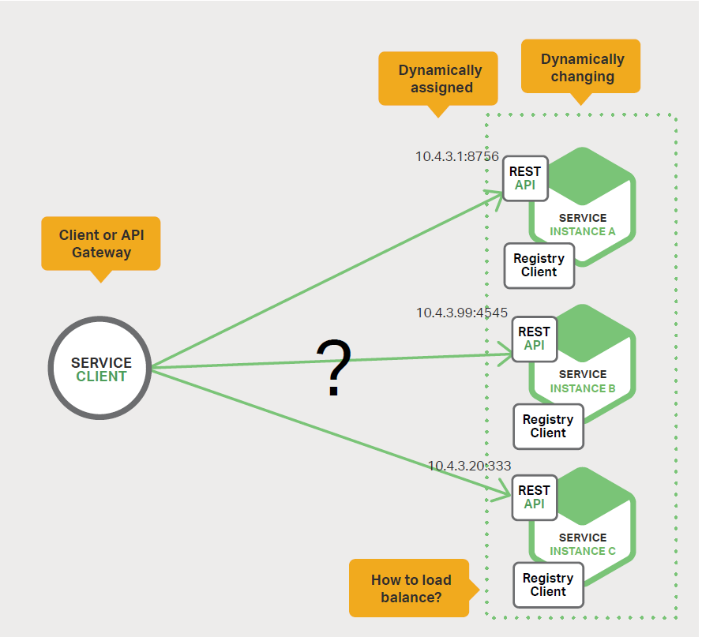
Why Use Service Discovery?

Slide 4
The Client-Side Discovery Pattern
Client is responsible for determining the network locations of available service instances and load balancing requests across them.
The client queries a service registry, which is a database of available service instances.
The client then uses a load-balancing algorithm to select one of the available service instances and makes a request.
The network location of a service instance is registered with the service registry when it starts up.
It is removed from the service registry when the instance terminates. The service instance’s registration is typically refreshed periodically using a heartbeat mechanism.

Slide 5
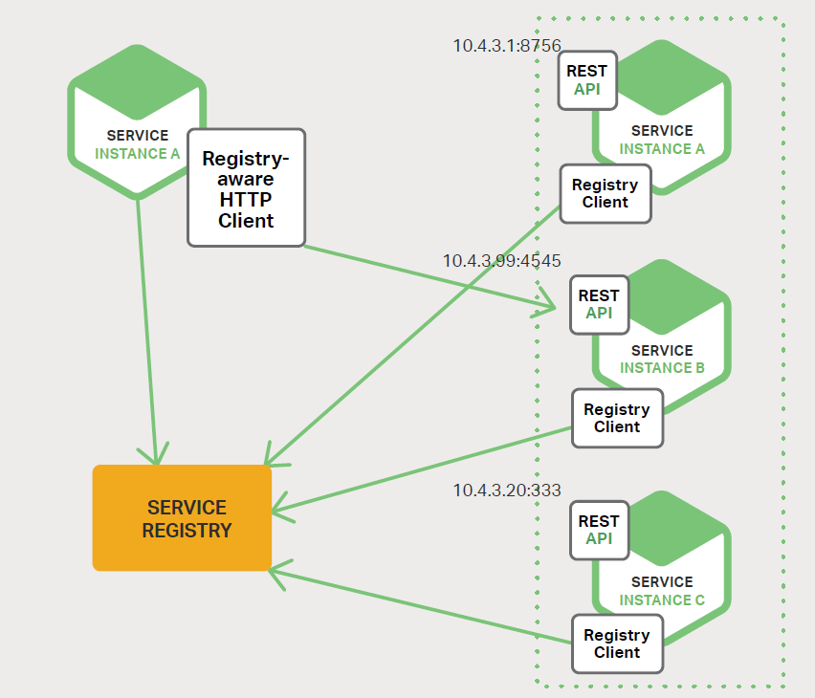
The Client-Side Discovery Pattern

Slide 6
The Server-Side Discovery Pattern
The client makes a request to a service via a load balancer.
The load balancer queries the service registry and routes each request to an available service instance.
As with client side discovery, service instances are registered and deregistered with the service registry
Example
AWS Elastic Load Balancer (ELB)
NGINX Plus and NGINXcan also be used as a server-side discovery load balancer
Some deployment environments such as Kubernetes and Marathon run a proxy on each host in the cluster. The proxy plays the role of a server-side discovery load balancer.

Slide 7
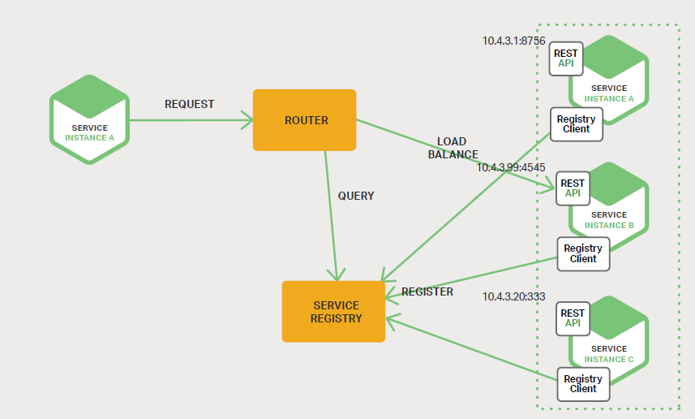
The Server-Side Discovery Pattern

Slide 8
The Service Registry
It is a database containing the network locations of service instances.
A service registry needs to be highly available and up to date.
Clients can cache network locations obtained from the service registry.
However, that information eventually becomes out of date and clients become unable to discover service instances. Consequently, a service registry consists of a cluster of servers that use a replication protocol to maintain consistency.
Examples
etcd
A highly available, distributed, consistent, key-value store that is used for shared configuration and service discovery.
Two notable projects that use etcd are Kubernetes and Cloud Foundry.
Consul
A tool for discovering and configuring services.
It provides an API that allows clients to register and discover services.
Consul can perform health checks to determine service availability.
Apache ZooKeeper
A widely used, high-performance coordination service for distributed applications.
Apache ZooKeeper was originally a subproject of Hadoop, but is now a separate, top-level project.

Slide 9
Service Registration Options
Service instances must be registered with and unregistered from the service registry.
Patterns
The Self-Registration Pattern
The Third-Party Registration Pattern

Slide 10
The Self-Registration Pattern
A service instance is responsible for registering and unregistering itself with the service registry.
Also, if required, a service instance sends heartbeat requests to prevent its registration from expiring.

Slide 11
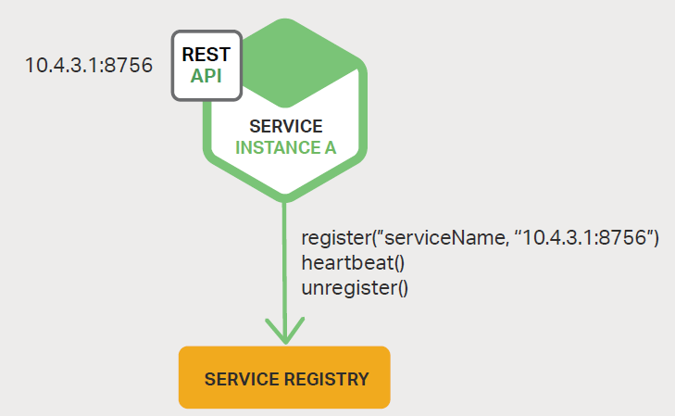
The Self-Registration Pattern

Slide 12
The Self-Registration Pattern
Advantage:
it is relatively simple and doesn’t require any other system components.
Disadvantages
it couples the service instances to the service registry.
You must implement the registration code in each programming language and framework used by your services.
Example
Spring Cloud project,

Slide 13
The Third-Party Registration Pattern
Service instances aren’t responsible for registering themselves with the service registry.
Instead, another system component known as the service registrar handles the registration.
The service registrar tracks changes to the set of running instances by either polling the deployment environment or subscribing to events.
When it notices a newly available service instance, it registers the instance with the service registry.
The service registrar also unregisters terminated service instances.
Example
Registrator Project

Slide 14
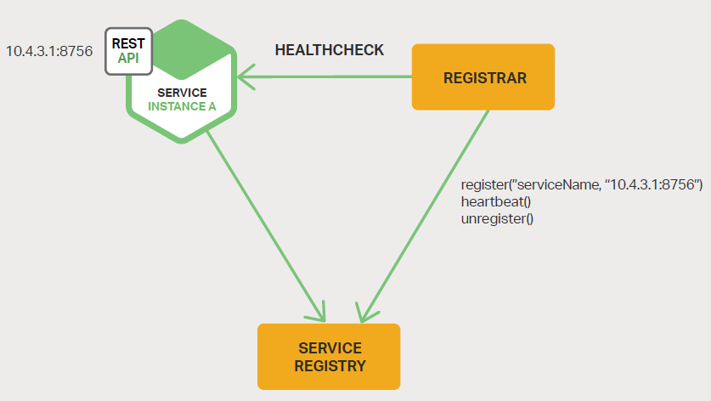
The Third-Party Registration Pattern

Slide 15
Thank You

